Slide 1
Maximize the Promise of Hyperconvergence by Thinking Outside the Storage Box
July 2017

Slide 2





Maxta Architecture
Maxta Global Namespace
MxSP
MxSP
MxSP
Hypervisor
Hypervisor
Hypervisor
Disk Drives
SSD
Disk Drives
SSD
Maxta Aggregated Storage Pool
Disk Drives
SSD
Server 1
Server 2
Server n
Ethernet
Data Services
Global Namespace
Snapshots
Clones
Capacity Optimization
Data Integrity & HA
Virtualization UI
Performance
Dynamic Auto Tiering
Optimize for SSD Cache
Application Defined
Optimize Block Size
Data Placement (locality)
Scalability
Scale Out
Scale Up
Scale Compute and Storage Independently
Multi-hypervisor support

Slide 3
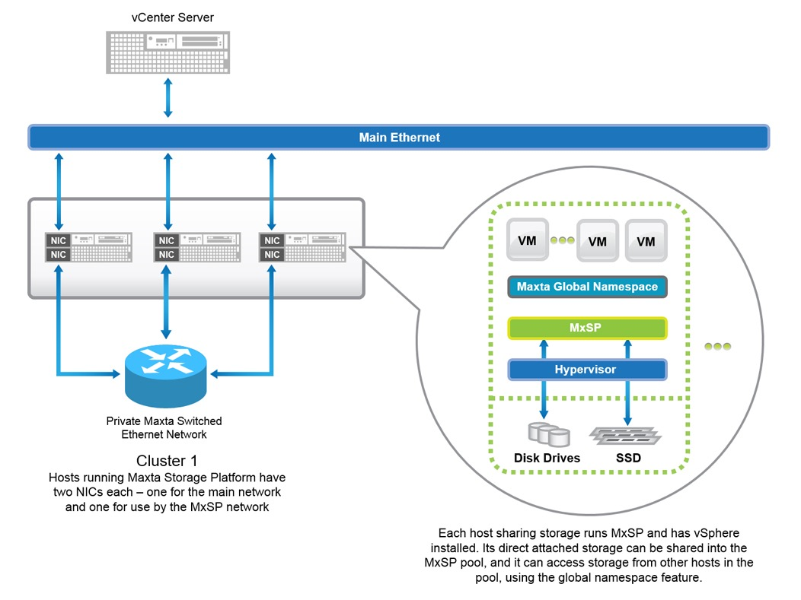
Typical Hardware Configuration
Maxta Confidential

Slide 4
Maxta Storage Platform – Design Principles

Slide 5
Maxta Storage Platform – Design Principles
Scale-out, Shared Nothing
Leverage Industry Standard Hardware
Leverage Heterogeneity of Vendors and Components
Enable Server / Storage Convergence
Support for DAS (internal drives/ JBOD)
Purpose Built for Virtualized Environments – Hypervisor Agnostic
Enterprise-Class Storage Services
Independent Scalability of Both Compute and Storage
Maxta Confidential

Slide 6
Maxta Software Stack Configuration

Slide 7
Configuration Details (1)
One Maxta Instance per Server: That is Part of the Cluster
Maxta Stack Runs Inside a VM (Linux based on ESX/Containers on KVM)
Maxta Stack Runs in User Space
Each Maxta Instance Provides an Entry Point to the Global Namespace/File System
Maxta Instance Best Practice: 20GB Memory, 4 CPU Cores
Improved performance with increased memory and CPU allocation
Maxta Confidential

Slide 8
Configuration Details (2)
Maxta Internode Communication
Shared or dedicated 10 Gig OR
Dedicated 1GigE
Server Attached Storage
Leverage pass through RDM on ESX, minimizes storage controller issues
Direct access to block devices on KVM
HDD: Leverage Low RPM, High Capacity Drives
Write optimized layout
Flash Best Practice:
10% of HDD capacity in flash
eMLC SSD or PCIe/NVMe flash
Optimized for NVMe flash for increased performance (NVMe for heavy workload and SATA SSD for lighter workload)
Spread out across 2 devices per node

Slide 9
Maxta Software Architecture

Slide 10
MxSP Feature
Software only solution
Application Defined
Linear Scalability
Maximize savings
Storage efficiency
Software Agility

Slide 11

Maxta Storage Platform Key Functional Blocks
Maxta File System (MFS)
Provides Distributed Filesystem
Handles IO (Read/Write)
Resync (synchronization) operations
Data Integrity
Highly Efficient snapshots and zero-copy clones
Object Manager
Layout Generation
Striping and mirroring distribution across cluster
Provides Fault Tolerance
Data Relayout during Disk and Node failures
Occurs automatically
Capacity Monitoring and Rebalance
Node Manager
Manage/report component health on each node
Help detect/replace/add faulty components on each node
Cluster Quorum Management (zookeeper)
Maintains file system global namespace
Make sure the cluster is running enough quorum servers
Automatic reconfiguration of quorum servers
MxIL (Deep Intent Log) & Read Cache
NVMe Optimized
In memory/SSD
Multiple LRU lists (recent/frequency for data/metadata)
NFS IP Manager
Fail over/fail back NFS IP
Maintain service delivery in spite of node faults

Slide 12
Architecture Overview
Browser (Orchestration)
MxCloudConnect (Call Home)
MxInsight (Management)
VM
VM
VM
VM
MxShell (CLI)
VMware vSphere
KVM
Rest API
NFS
VM Creation
MxInsight (Management)
Object Manager (OM)
Namespace
(Zookeeper)
MFS
Peer Nodes
Maxta File System (MFS)
Rest API
Data Relayout
Capacity Balancer
Maxta Messaging Protocol
Maxta Messaging Protocol
Zookeeper
Perf Stats
Cluster Config
Node Services Node Add/Remove Disk Add/Remove
LFS
MXIL
Linux OS
Hypervisor
Disk

Slide 13
Main Components
MFS
Object Manager
Database
Zookeeper
NFS
Management
MxCloudConnect
MxInsight

Slide 14
Services
System Level
monit to monitor system status
nfsd for the NFS v3 server
Maxta File System (MFS)
mfsd for MFS
mfsmonit to monitor MFS
Object Manager (OM)
omNodeWatcher to monitor node status
omWalker to initiate resync when necessary
Management Framework
Tomcat to provide management API
ZooKeeper to provide clustering services

Slide 15
NFS
Shared storage is mounted as NFS Datastore
Currently we are using NFSv3
Mount point: /mount uuid
Folder: /maxta
Only support Thin provisioning currently

Slide 16
Clustering and Unified Namespace
Clustering — zookeeper
Provides synchronization and maintains a quorum across all nodes
Minimum of three node
Unified Namespace
Provides all nodes in the Maxta cluster with visibility to the same hierarchy of objects
Minimum of three node
Remains global consistent

Slide 17
Maxta File System

Slide 18
Maxta Distributed File System
MxSP uses Maxta’s own highly scalable, resilient Maxta Distributed File System (MFS) to deliver shared storage with enterprise class services.
MFS eliminates split-brain conditions by synchronizing operations between instances across the cluster.
MFS runs on each server in the virtualization cluster to deliver a highly available and scalable global namespace.

Slide 19

Read I/O Path
Application VM
6
1
MFS on Node 0
Network IO
MFS on Node 1
Network IO
Network IO
MFS on Node N
1
1
1
2
3
4
5
2
3
4
5
1
1
1
2
MxIL
2
MxIL
2
MxIL
3
In Memory
3
In Memory
3
In Memory
4
Read Cache
4
Read Cache
4
Read Cache
5
HDD
5
HDD
5
HDD
A Maxta read I/O is processed through the local MxSP instance closest to the VM guest.
If the data is dirty (has not yet been moved from MxIL to spinning disk) then it is read directly from MxIL.
The next level of read caching is the MxSP memory.
If there is a cache miss from memory then the data is fetched from the read cache residing on flash media.
If the data is not found in flash, MxSP will read the data from HDD.
The read I/O is acknowledged back to the application VM after striped data has been read from all nodes.

Slide 20
Write I/O Path
Application VM
4
1
MFS on Node 0
Network IO
MFS on Node 1
Network IO
Network IO
MFS on Node N
2
2
2
3
3
3
3
2
3
2
3
2
MxIL
MxIL
MxIL
5
5
5
HDD
HDD
HDD
A Maxta write I/O is processed through the local MxSP instance closest to the VM guest.
The data is striped as widely as possible and replica copies are created. The data and its replicas are written across the network to MxIL residing on flash media on at least two different nodes.
Each node acknowledges that data has been written to flash media.
The write I/O is acknowledged back to the application after all data, including replicas, has been written to flash.
Data is eventually de-staged onto spinning disk.

Slide 21
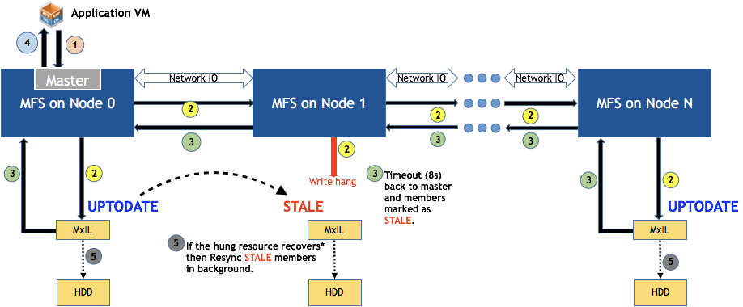
Write operation timeout(Resync)

Slide 22
Resynchronization Operations
Occurs as a Background Task
Prioritized Lower Than VM Workload Operations
Ability to Set VM Resync Priority
i.e. some VMs have higher priority than others
Types of Resyncs
Incremental
Resync ONLY the “delta” changes
Full
Entire dataset is resynchronized

Slide 23
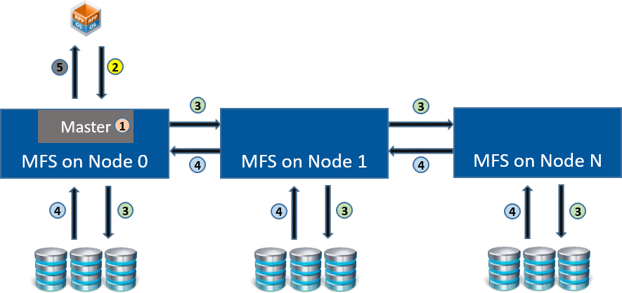
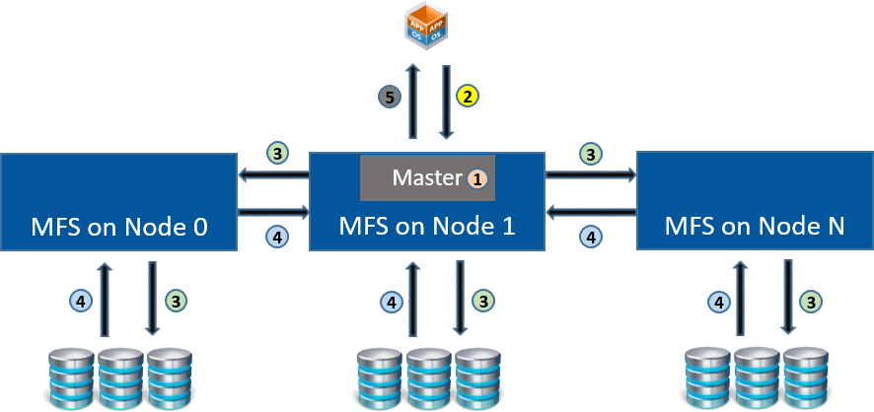
Floating Master (1)
Traditional storage systems maintain a master for all VMs, exists in a server-client relationship and can become a bottleneck for IO traffic.
Maxta allows the role of master to be passed from node to node and by maintaining masters on a per-VM basis.
Floating master can eliminate unnecessary network hops in the case of a VM migration
Improved Performance
I/O Path with Floating Master after VM is deployed
I/O Path with Floating Master after VM is migrated

Slide 24
Floating Master (2)
The VM’s master resides with the VM on Node 0.
Reads and writes come from the VM into Node 0.
The master directs these IOs across the network to the appropriate nodes.
The nodes send their acknowledgements back to the master on Node 0.
The master on Node 0 sends the acknowledgment to the VM.

Slide 25
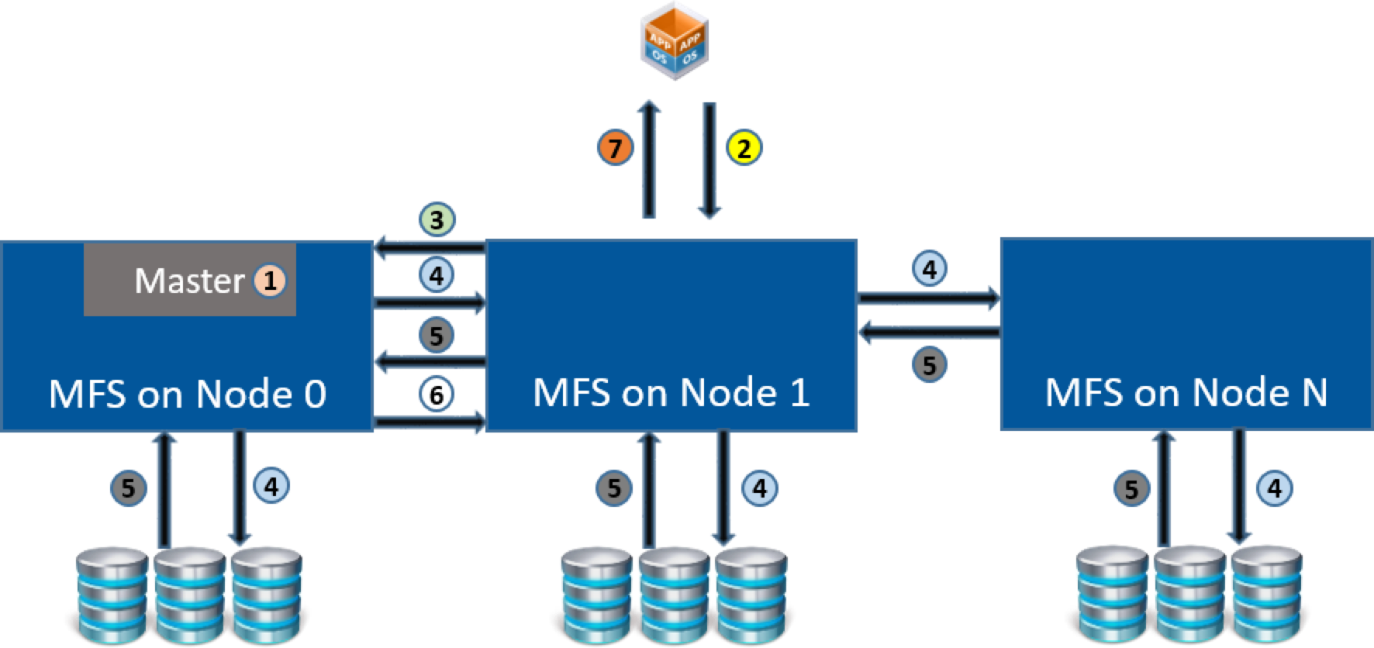
Floating Master (3)
Now, if that VM is migrated from Node 0 to Node 1 without MxSP’s concept of a floating master:
The master remains on Node 0.
Reads and writes come from the VM into Node 1.
Node 1 sends the IOs to the master on Node 0.
The master directs these IOs across the network to the appropriate nodes.
The nodes send their acknowledgments back to the master on Node 0.
The master on Node 0 sends the acknowledgement to Node 1, where the VM resides.
Node 1 sends the acknowledgement to the VM.

Slide 26
Floating Master (4)
With MxSP’s floating master, after the VM has been migrated to Node 1:
The master moves with the VM to Node 1.
Reads and writes come from the VM into Node 1.
The master directs these IOs across the network to the appropriate nodes.
The nodes send their acknowledgments back to the master on Node 1.
The master on Node 1 sends the acknowledgment back to the VM.

Slide 27
End-to-End Data Integrity
MxSP Delivers End-to-End Data Integrity Without Hardware Changes to the Server Configuration
Prevent silent data corruption
Utilizes Strong Checksum
validated on each read
Checked whenever the data is stored (MxIL, read cache, metadev, de-stage to HDD or across the network)
MxSP Validates the data within a block
MxSP Validates the block itself
Data/blocks are self healed when checksum miss-compares
Repair and recover by patching it with the correct data from an available replica copy

Slide 28
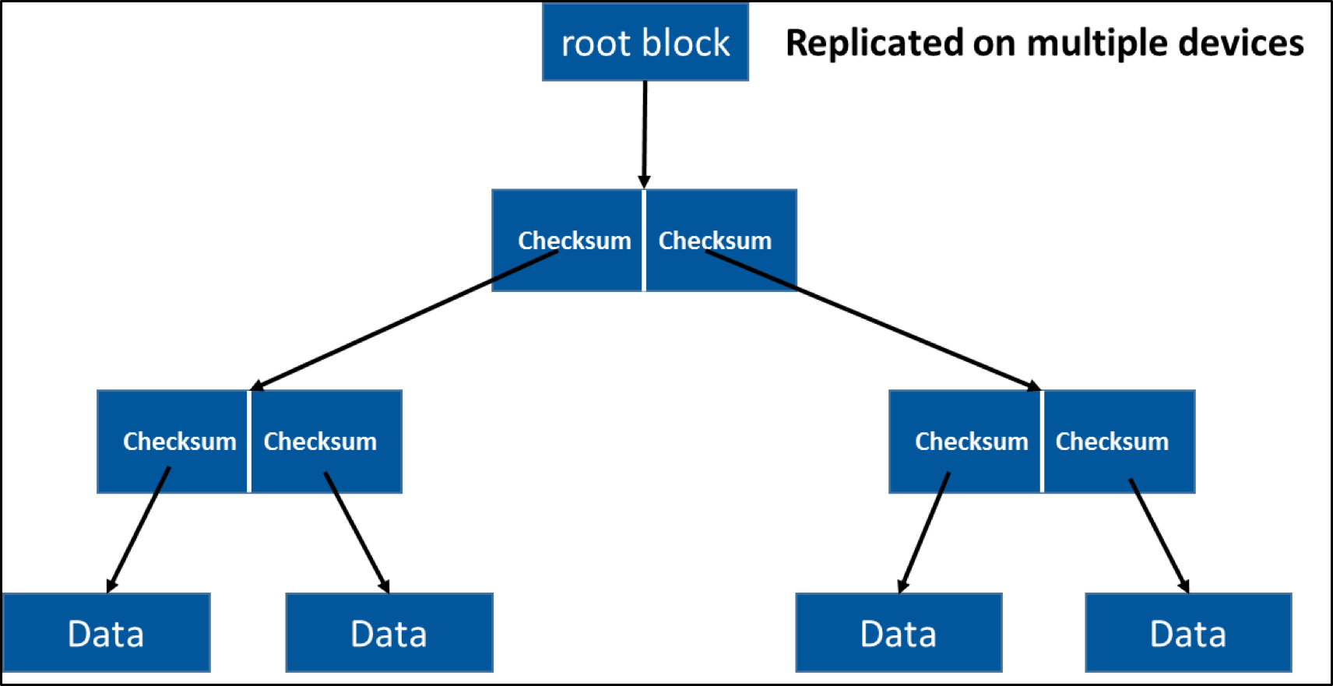
Data Integrity
MFS Checksum Tree Structure
Root block is replicated across various devices
When checksum and data disagree
MFS trusted checksum as it is part of some other block (has been verified) and one level higher in the tree

Slide 29
Object Manager

Slide 30
Object Manager
File-object placement
Layouts are a combination of Striping(RAID 0) and Mirroring (RAID 1) — RAID 10
Striping
StripeSize = min(floor (#HDDs/#copies), 8) — 8-wide striping is MAX
Horizon striping
stripe across nodes
stripe firstly then Mirror
Vertical striping — Not available
stripe within nodes
Mirror firstly then Stripe
Rebalance

Slide 31
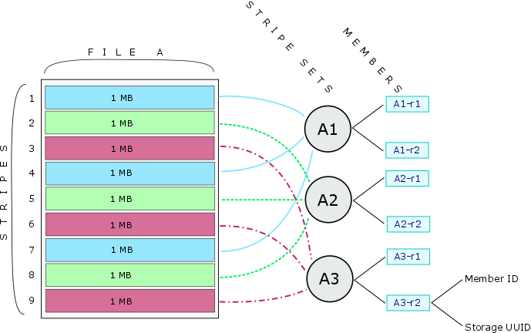
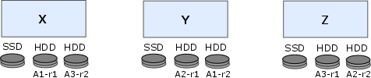
Striping Data Across Multiple Nodes
X, Y, Z – Represent Nodes
Stripe Size – 1 MB
Stripe Set (Width) = No. of Disks / No. of copies
Member = Number of copies of data

Slide 32
Horizontal Striping
2 HDD for each node, 6 HDD total
3 copies
stripe width = 6/3 = 2
Stripe First, Mirror Next
Best for applications requiring higher IOPS
Node / Server
Node / Server
Node / Server
1
2
3
SSD
HDD
HDD
SSD
HDD
HDD
SSD
HDD
HDD
A1
A2
A3
A1’
A2’
A3’
Replica
Replica
File "A" is Striped 3-way and Mirrored 2-way

Slide 33
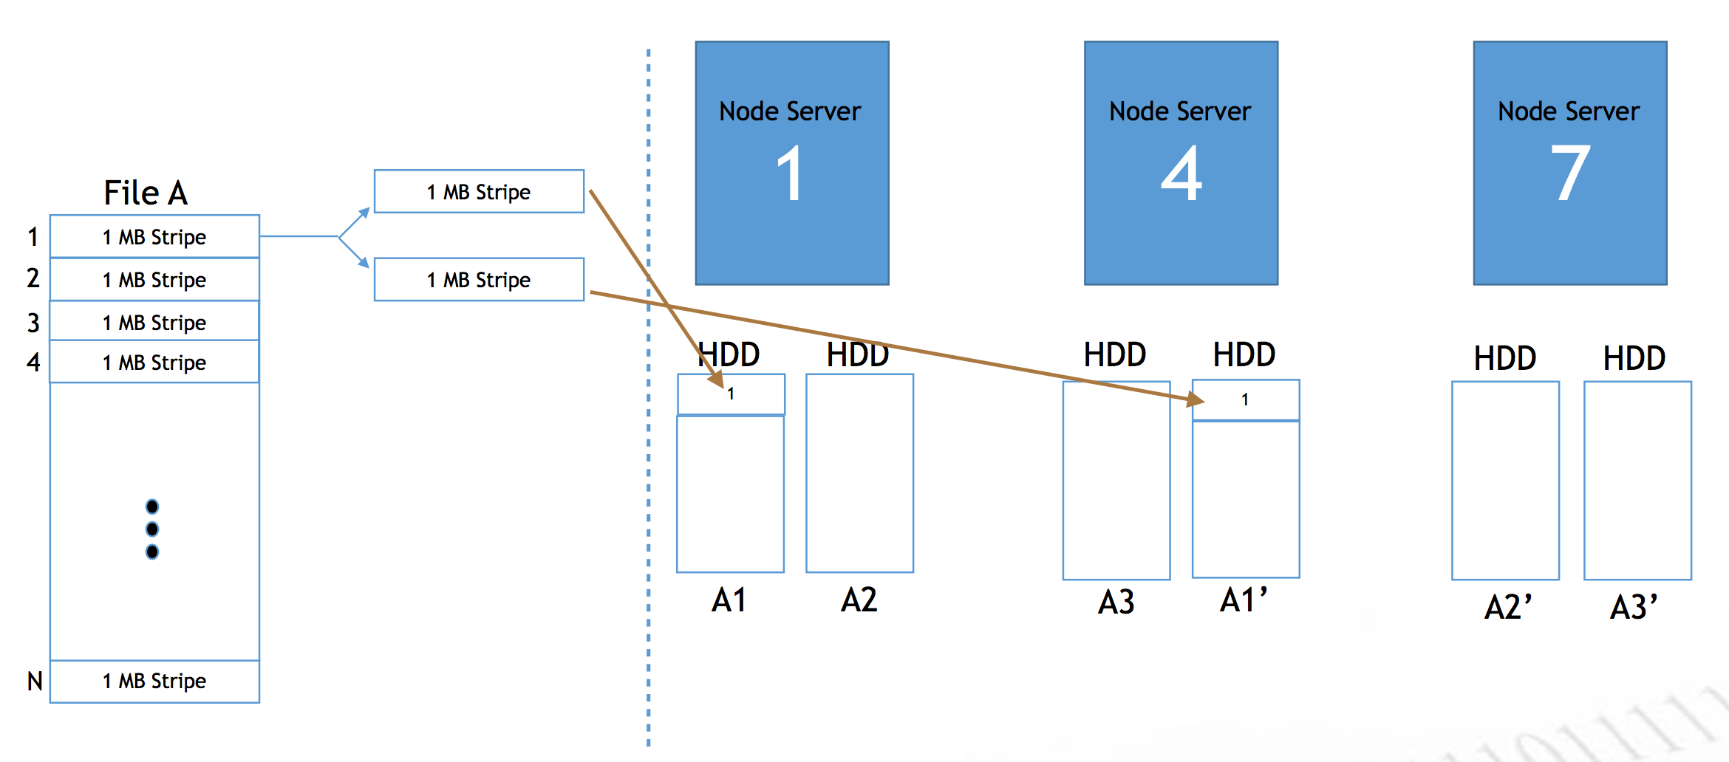
Horizontal Striping
stripe
stripe set

Slide 34
Vertical Striping
Mirror First, Stripe Next
Best for applications requiring low latency and high throughput
Node / Server
Node / Server
Node / Server
2
3
1
SSD
HDD
HDD
SSD
HDD
HDD
HDD
SSD
HDD
HDD
A1
A2
A1
A2
A3
File "A" is Mirrored 2-way and Striped Within the Node

Slide 35
Data Re-layout (1)
Cluster-wide Capacity Balancing
Favors Placement of New Data on New/Underutilized Disks/Nodes
Periodic Rebalancing Across Disks/Nodes
Proactive Data Relocation

Slide 36
Data Re-layout (2)
Data Re-layout is used to handle
Errors
Capacity Rebalance
Service (Disk removal, Node removal)
Types of data re-layout
Data relocations — replace individual members
Data reconstructs — Build new RAID tree

Slide 37
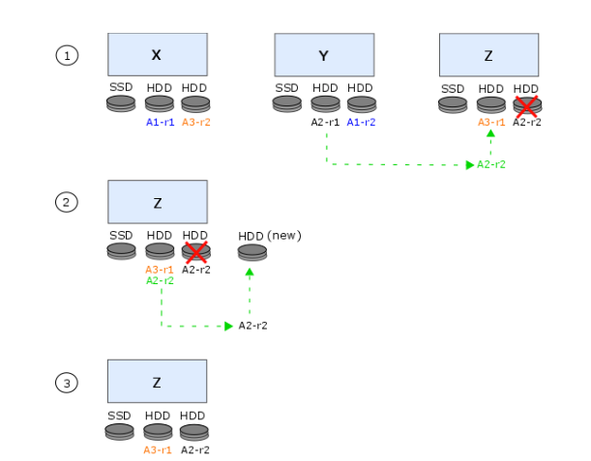
Data Relocate (1)
File A has three members (A1-r1, A2-r1, A3-r1) and three replicas (A1-r2, A2-r2, A3-r2) striped across HDDs in nodes X, Y, and Z.
There is a drive failure on node Z, and the failed disk is replaced.
Automated Service Action
Scenarios for Relocate Data
Drive/Node Failure
Capacity Rebalance
Objective
Keep the data on the same server to protect wide striping

Slide 38
Data Relocate (2)
On node Z, the drive containing replica A2-r2 has failed. Object Manager rebuilds the data from A2-r1 onto a co-located copy (A2-r2) on the same drive containing A3-r1.
A new drive is installed on the same node where the previous drive failed. There is an imbalanc in capacity usage per disk in the cluster.
Object Manager moves data from the overutilized disk containing A3-r1 and A2-r2 to the newly added disk. In the diagram above, A2-r2 is moved to the new disk.
Once the resync between A2-r2 on the overutilized disk and A2-r2 on the new disk has completed, the copy of A2-r2 on the overutilized disk is removed by Maxta Object Manager.

Slide 39
Data Relocate (3)
What would happen if the disk was not replaced, or if instead of a single drive replacement, multiple disks are added to increase capacity of the cluster?
In the event that the disk is not replaced, the copy of A2-r2 remains on the same drive containing A3- r1 with no adverse effects.
If a new disk is added to node X, if a new node is added to the cluster, or if additional capacity is added to each node in the cluster, MxSP then rebalances all data across the nodes in order to ensure that data is striped as widely as possible across the nodes.

Slide 40
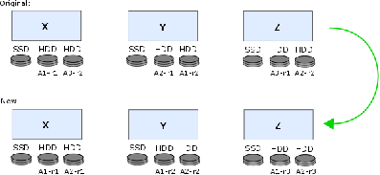
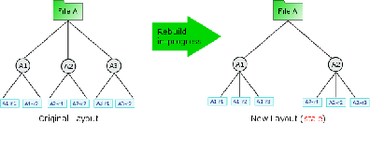
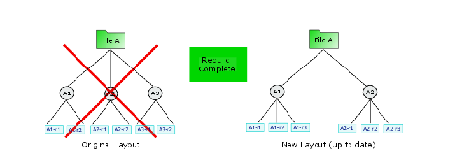
Data Reconstruct (1)
Automated Service Action Scenarios for Reconstruct Data
Change the number of Replica copies
Add new Drive or Node
Objective
Protect wide striping

Slide 41
Data Reconstruct (2)
Data reconstruction is capacity intensive. Object Manager limits how concurrent reconstructs can take place and avoids pushing storage pools above 75% utilization. If data reconstruction cannot be achieved due to a lack of capacity, then Object Manager will delay the migration until more storage becomes available.
For example, if your original configuration is 2TB and you are increasing from two to three replica copies, your new configuration will require 3TB of capacity. During reconstruction, you will need at least 5TB of capacity to support the increase in replica copies. Once reconstruction completes, the 2TB from the original configuration is freed.

Slide 42
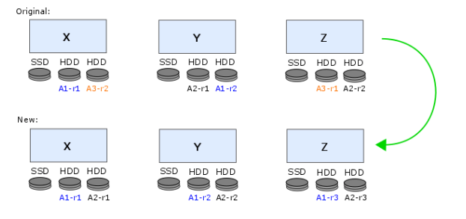
Data Reconstruct (3)
There are six HDDs and two replica copies (originally), meaning there are three stripe sets.
File A has six members and replicas (A1-r1, A1-r2, A2-r1, A2-r2, A3-r1, A3-r2) striped across nodes X, Y, and Z—the original configuration consists of three stripes (A1, A2, A3) with 2-way mirroring (-r1, -r2).
The mirroring policy for a cluster containing nodes X, Y, and Z has been changed from 2-way mirroring to 3-way mirroring.
Because no additional disks have been added, the stripe width decreases from three to two.
Due to the large amount of data to be re-mirrored, the data is reconstructed rather than relocated.

Slide 43
Data Reconstruct (4)
Maxta Object Manager creates the new data configuration and begins rebuilding the data.
In the new configuration, file A is restriped and mirrored across nodes X, Y, and Z. Stripe width decreases from three to two.
I/O continues on the original configuration while data is synced between the original and new configurations. While data is syncing, the new configuration is marked as stale.
Once the data sync has completed, Maxta Object Manager transfers all I/O to the new configuration and removes the original configuration.

Slide 44
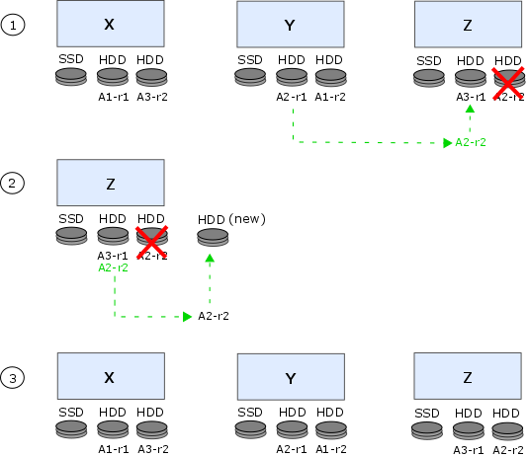
Automatic Rebalance – Add / Replace Disk or Node
Disk or Node Failure
Negligible Degradation to Performance
Automatically Copy Data to different disk in the Cluster
Entire Cluster is a Spare Cluster
Disk or Node Addition
Automatic Rebalance
QoS
Ability to throttle the number of rebuilds
Default to lower priority than production IO
Minimize data movement

Slide 45
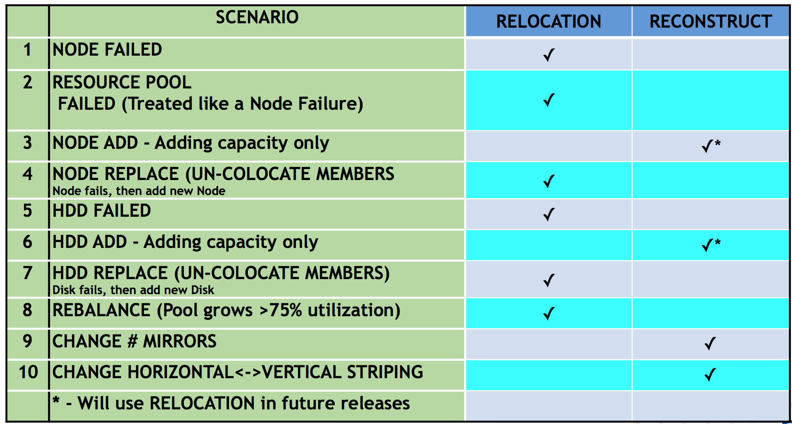
Data Re-layout Summary

Slide 46
Maxta Management

Slide 47
Management Service
Management service
A gateway to MxSP
Establish SSH connections the other CVM
Stateless (its state is contained in the unified namespace)
CLI and REST APIs
Leverage to facilitate cluster management tasks
MxCloudConnect
A cloud based proactive reporting and alerting system which is included as part of the standard MxSP installation.

Slide 48







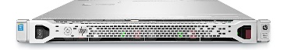
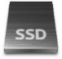

VM-Centric Management
Manage VMs and Not Storage
No LUNs, Volumes, RAID Group to Manage
Eliminate the Complexities of LUN Masking, Zoning
Data Services Configured and Managed at the VM level
Aggregated Storage Pool
Hypervisor
Hypervisor
Hypervisor

Slide 49
Management and User Interface
Management Server is Stateless
Well Documented REST APIs Exposed by Management Server
Proactive Monitoring/Alerting for HW, Space Utilization, Critical Events
On-premise
Cloud-based
HTML 5 Based UI

Slide 50
Application Defined Storage

Slide 51
Example: Benefit of Application Defined Storage – Page Size
Page Size
Storage > Application
Page Size
Application > Storage
Page Size
Application = Storage
App
4K
4K
4K
4K
4K
4K
4K
4K
Storage
32K
App
32K
Storage
32K
App
4K
4K
4K
4K
4K
4K
4K
4K
Storage
32K
Have to wait for application to deliver 8 IOs before writing to 32K page on disk
This creates a major performance penalty
Multiple disk access for a single application read/write
Have to go to disk 8 times to allocate enough space for 32K IO coming from app
Need to find 8 contiguous blocks available on disk
Application page size aligned with storage page size
Individual page on storage can be allocated for individual IO from application

Slide 52
Application Defined Use Case – Microsoft Exchange
Maxta Storage Platform (MxSP)
Jetstress Parameters
Number of threads | 16
Database size | 500 GB
Performance Metrics
Achieved Transactional IOPS (4K) | 857.505
Achieved Transactional IOPS (32K) | 1022.837
Percentage Improvement | 19.28%
Estimated IOPS per User | 0.40
Additional Users | 400
Configuration Notes
4K random IO workload running in background
Jetstress configured once with 32K and once with 4K page size
All workloads run simultaneously on same Maxta storage
Key Takeaways
Application defined storage for Exchange brings 20% performance gain
Maxta’s page size policies enable 400 more mailboxes than uniform storage

Slide 53
Additional Product Features

Slide 54
SSD Caching
MxSP maximizes the performance to cost benefit of hybrid storage solutions by utilizing flash media for intent log, read cache, and flash accelerated metadata.
SSD Mirroring
MxIL, Metadev will be mirrored
With SSD mirrored, single SSD failure will not resulted in Node failure.
Recommend a minimum of two flash media devices per node

Slide 55
MxIL/Read Cache
MxIL: Maxta Intent Log (Write Cache)
Resides on flash media and primarily for write transactions (Refer to ZIL)
100GB/200GB
Spread across up to four flash devices on each node
Use COW (write and changes will be kept if there have enough space)
Read Cache (Refer to L2ARC)
100-300GB

Slide 56
Metadev
A class of device in the Maxta file system.
Stores only the file system metadata to accelerate the read/write performance of metadata IOs.
Separate metadata from data, stored on high performance devices (like SSDs).
The HDD to Metadev ratio depends specially on the page size defined during the MxSP deployment.
Page size= 4K, metadev=5% x(HDD capacity)
Page size= 8K, metadev=3% x(HDD capacity)
Currently fixed ratio 5% is used

Slide 57
Disk Layout
Resource pool - MxIL
Pool 1 - Configuration
HDD
Pool 1 - Data
Resource pool - Read Cache
Resource pool - Configuration
Resource pool - Data
Pool 2 - Configuration
SSD
HDD
Pool 2 - Data
Pool 1 - Metadev
Pool 2 - Metadev
Pool 3 - Metadev
Pool 3 - Configuration
HDD
Pool 3 - Data

Slide 58
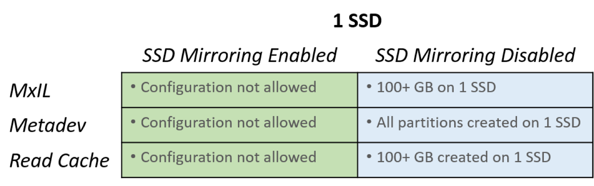
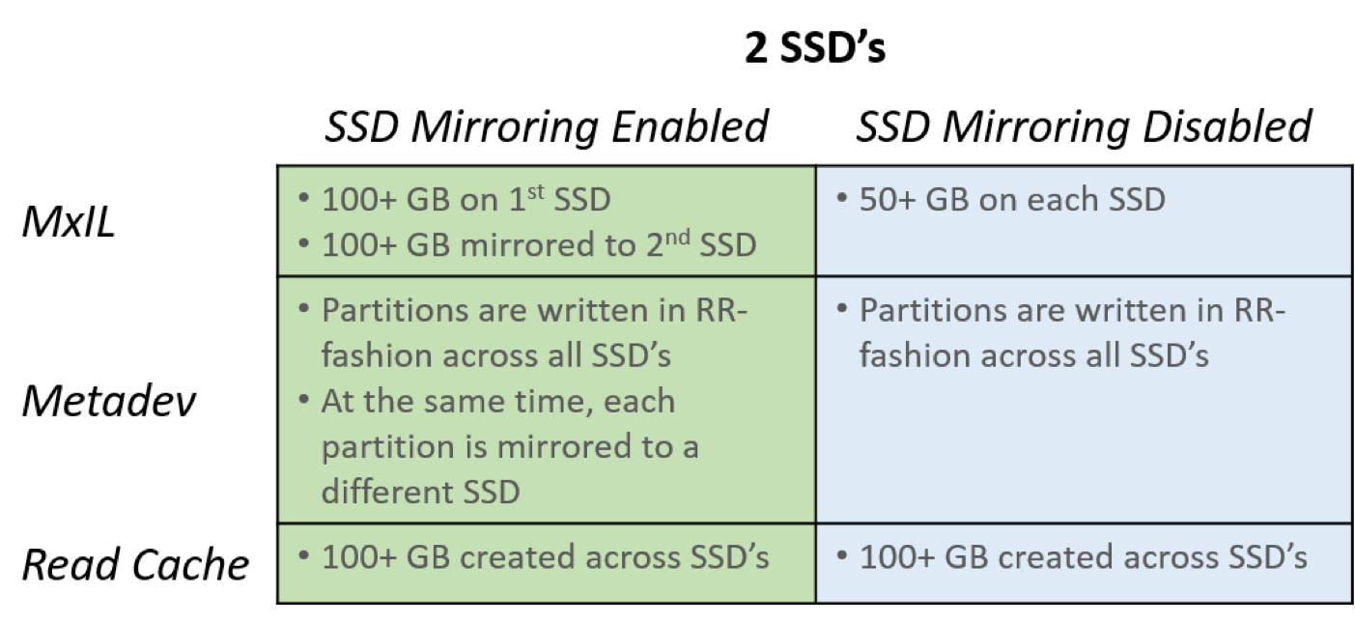
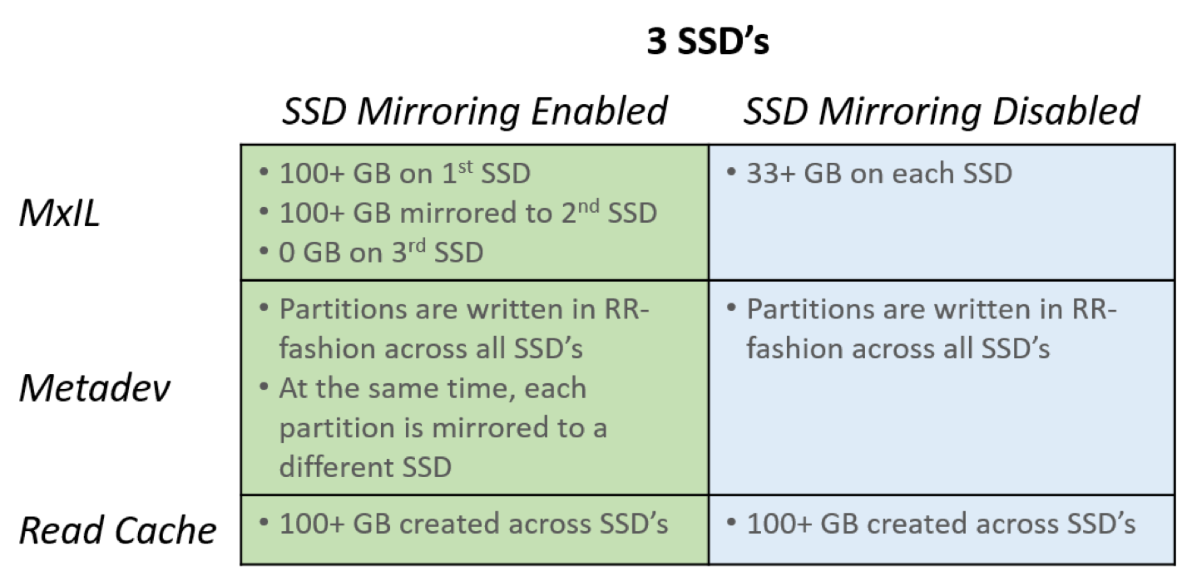
SSD Layout (1)

Slide 59
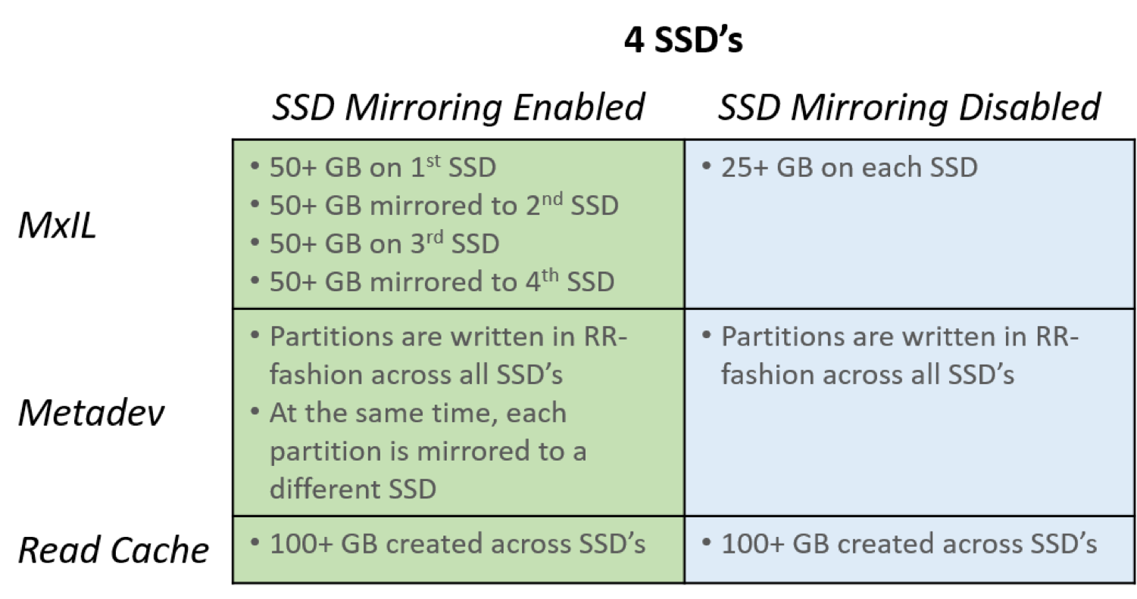
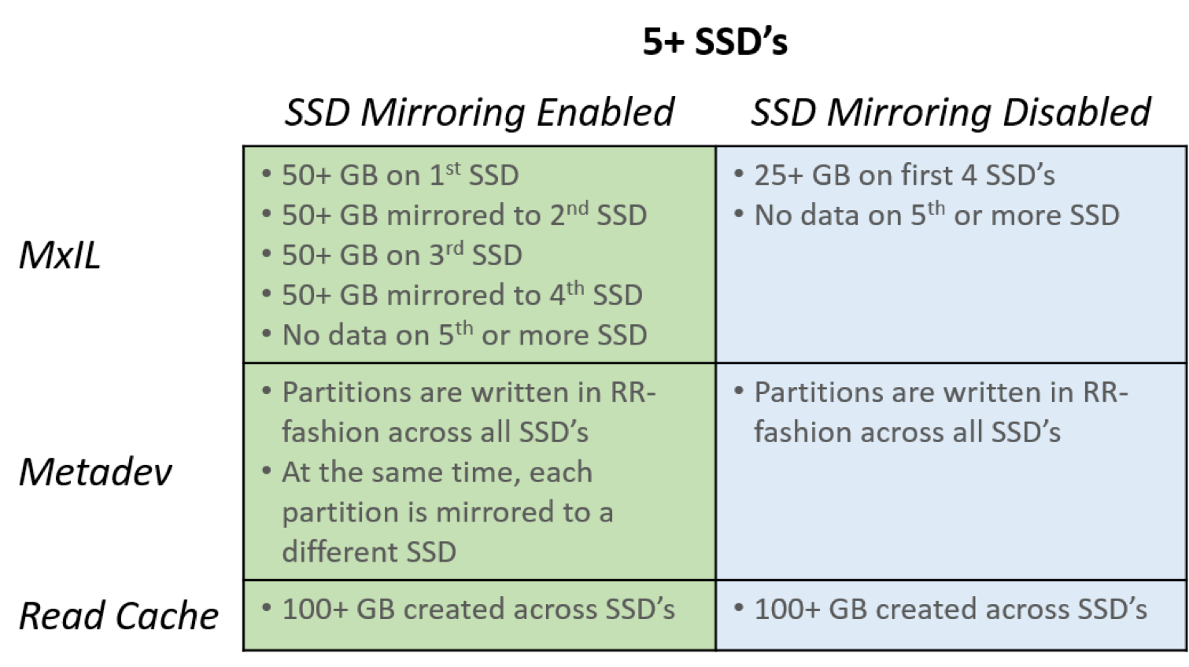
SSD Layout (2)

Slide 60
Policy Management
Provides further granularity and control over the hyper-converged environment
per-Datastore Basis
per-VM Basis
per-vDisk Basis
Page size
The size of the I/O request made by an application to the storage
4KB,8KB,16KB and 32KB
Compression
LZ4, gzip_opt, gzip_high, disabled.
Recommend using LZ4
In-line compression and it happened while de-stage to HDD

Slide 61
Policy Management - per-Datastore
We can only configure below while installing MxSP
Page size
Compression
Read Cache
MxIL

Slide 62
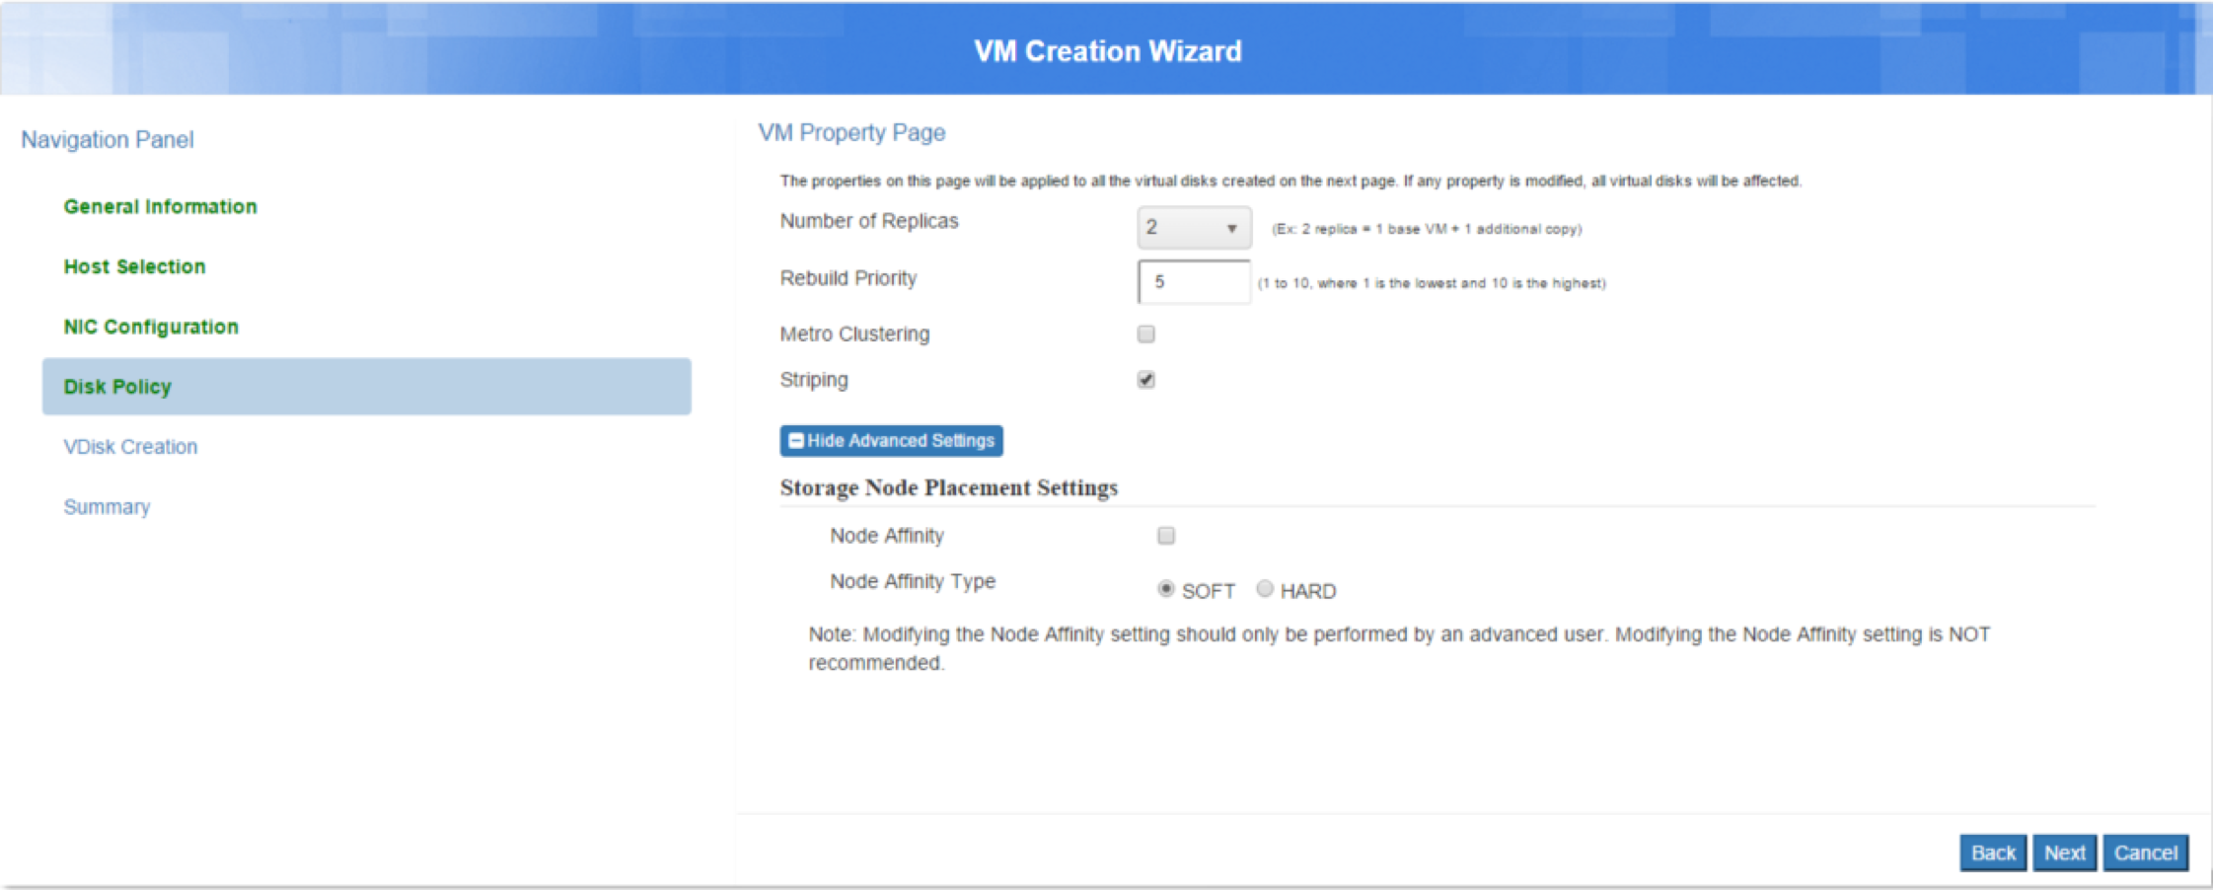
Policy Management - per-VM

Slide 63
Policy Management - per-VM
Striping
Horizon/Vertical Striping
Number of Replicas
Specify the number of replicas (2 or 3)
Node affinity (Not available Now)
Data placement is constrained to a specified set of nodes
A minimum of two nodes must be selected for an affinity group
Affinity group type
Soft
Hard
Rebuild Priority
1~10, 1 is the highest

Slide 64
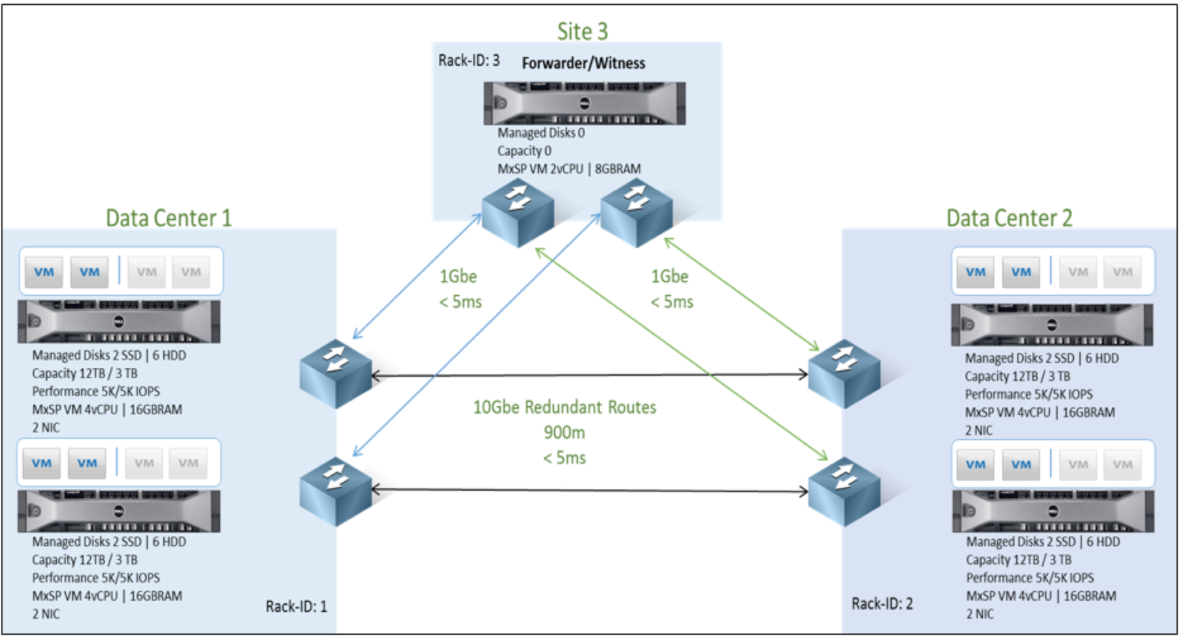
Policy Management - per-VM
Metro Storage Cluster (aka Rack awareness)
synchronous replication
5ms RTT for storage network

Slide 65
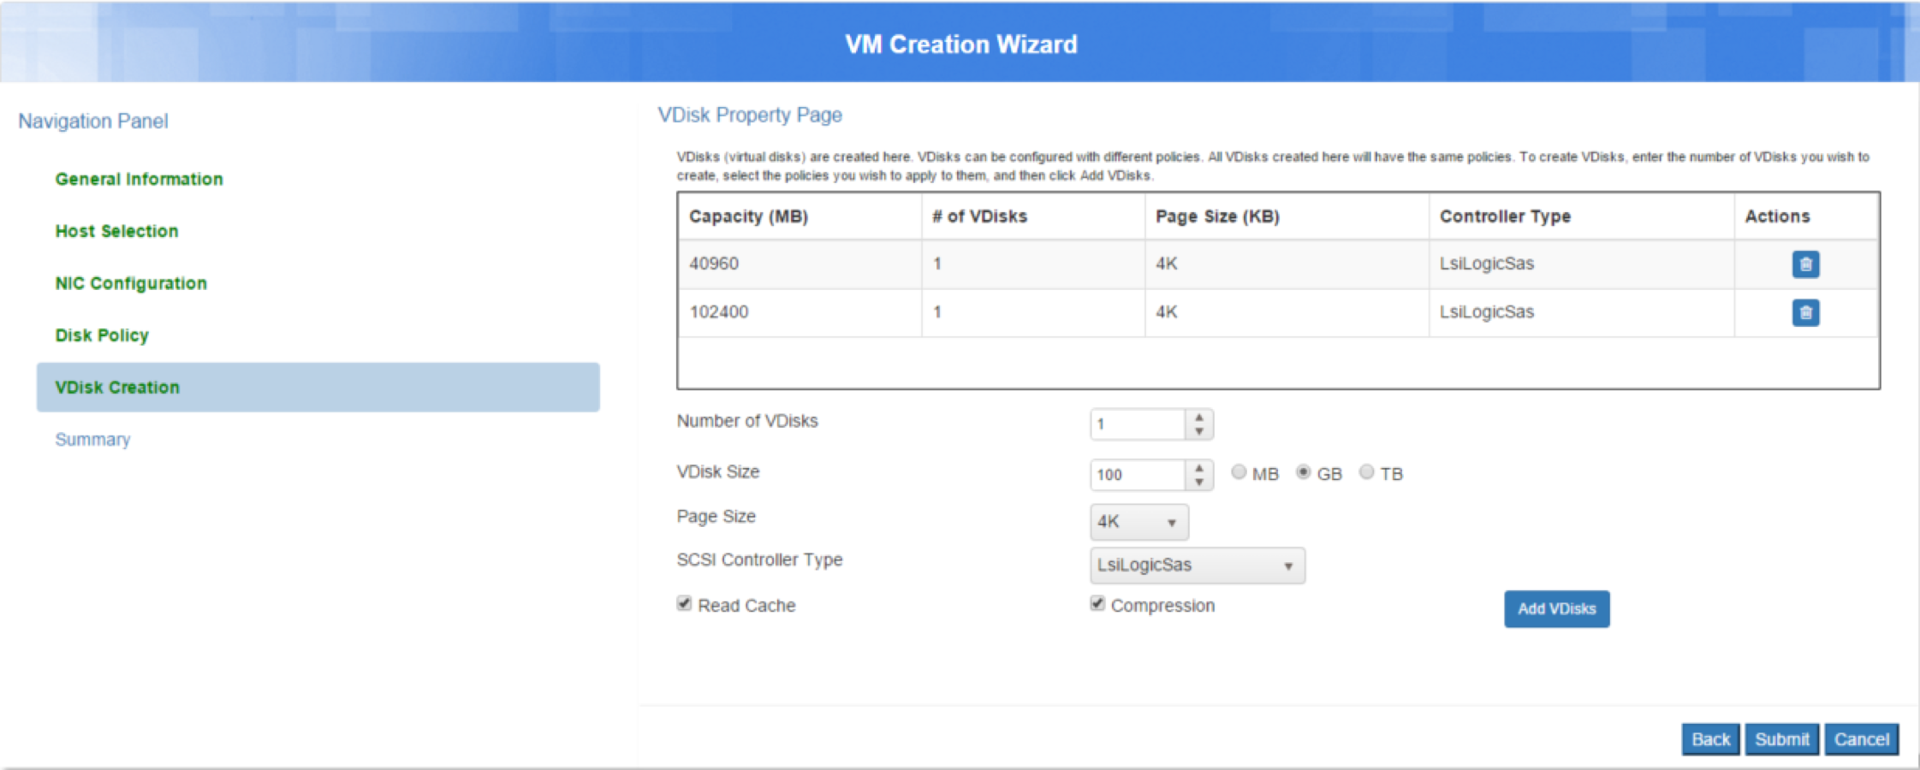
Policy Management - per-VDisk

Slide 66
Policy Management - per-VDisk
Page size
Can be different from what we set during installation
Application independent
Compression
Read Cache

Slide 67
Maximize Storage Efficiency
Thin Provisioning
No upfront reservation
Reduces capital expenditures, by boosting capacity utilization
Lower operating expenditures, by eliminating administrative tasks
Capacity Efficient Snapshots and Clones
Compression
Inline reduction with no performance penalty
Increase capacity utilization by 2X – 3X
Purchased physical capacity
Allocated capacity
Written Data
Written Data
Written Data

Slide 68


Highly Efficient Snapshots and Clones
Unlimited VM level Snapshots and Zero Copy Clones
Extremely fast and efficient
No upfront reservation of space
Ability to uniquely revert to every snapshot
Enable backup without impact to production applications
Enable instant provisioning of new VMs
Global Namespace
MxSP
Hypervisor
Maxta Snapshot
Maxta Storage

Slide 69
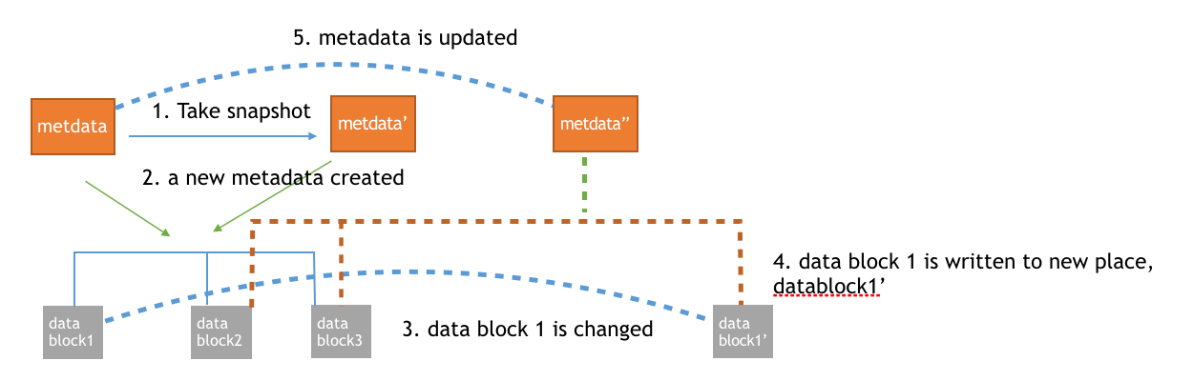
Snapshot (1)
Provide unlimited number of time, performance, capacity-efficient zero-copy
Enabled on VM level NOT storage level
A log based layout approach for data placement and metadata for mapping data blocks to their storage location
Read only

Slide 70
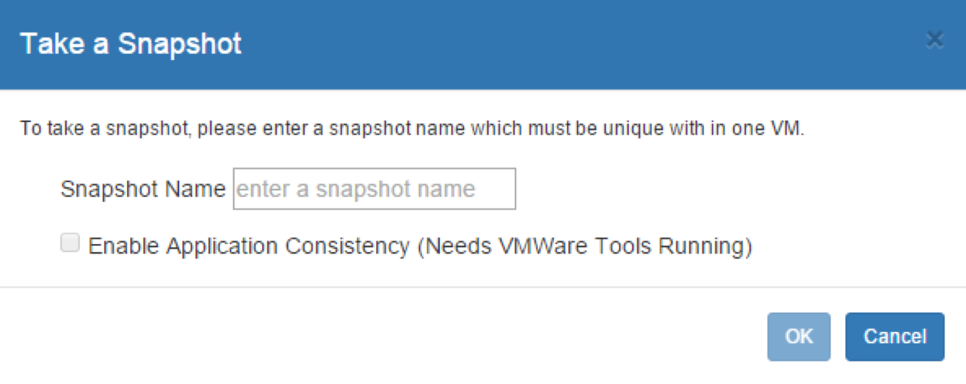
Snapshot (2)
Application Consistent Snapshots
Provide the appropriate tools for application consistent snapshots (e.g., VSS quiescing)

Slide 71
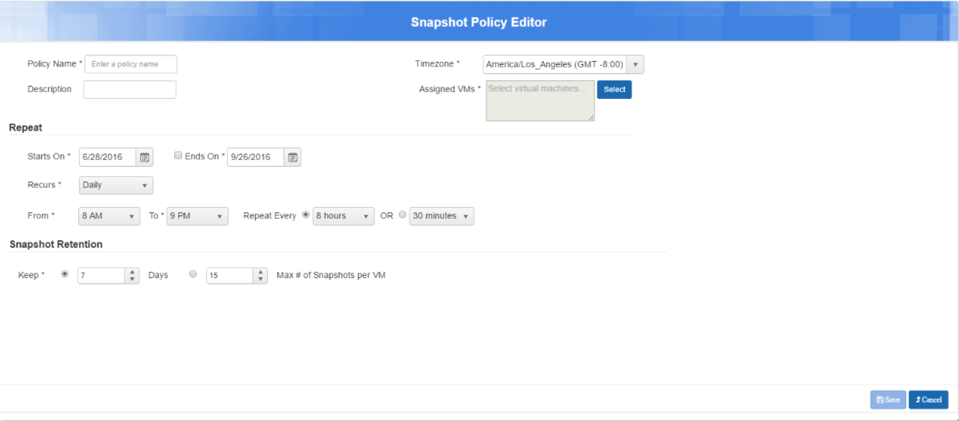
Snapshot Policy
Create Maxta’s zero-copy snapshots for a VM or set of VMs based on a schedule defined by the user
Provides data protection by creating a periodic checkpoint of VMs

Slide 72
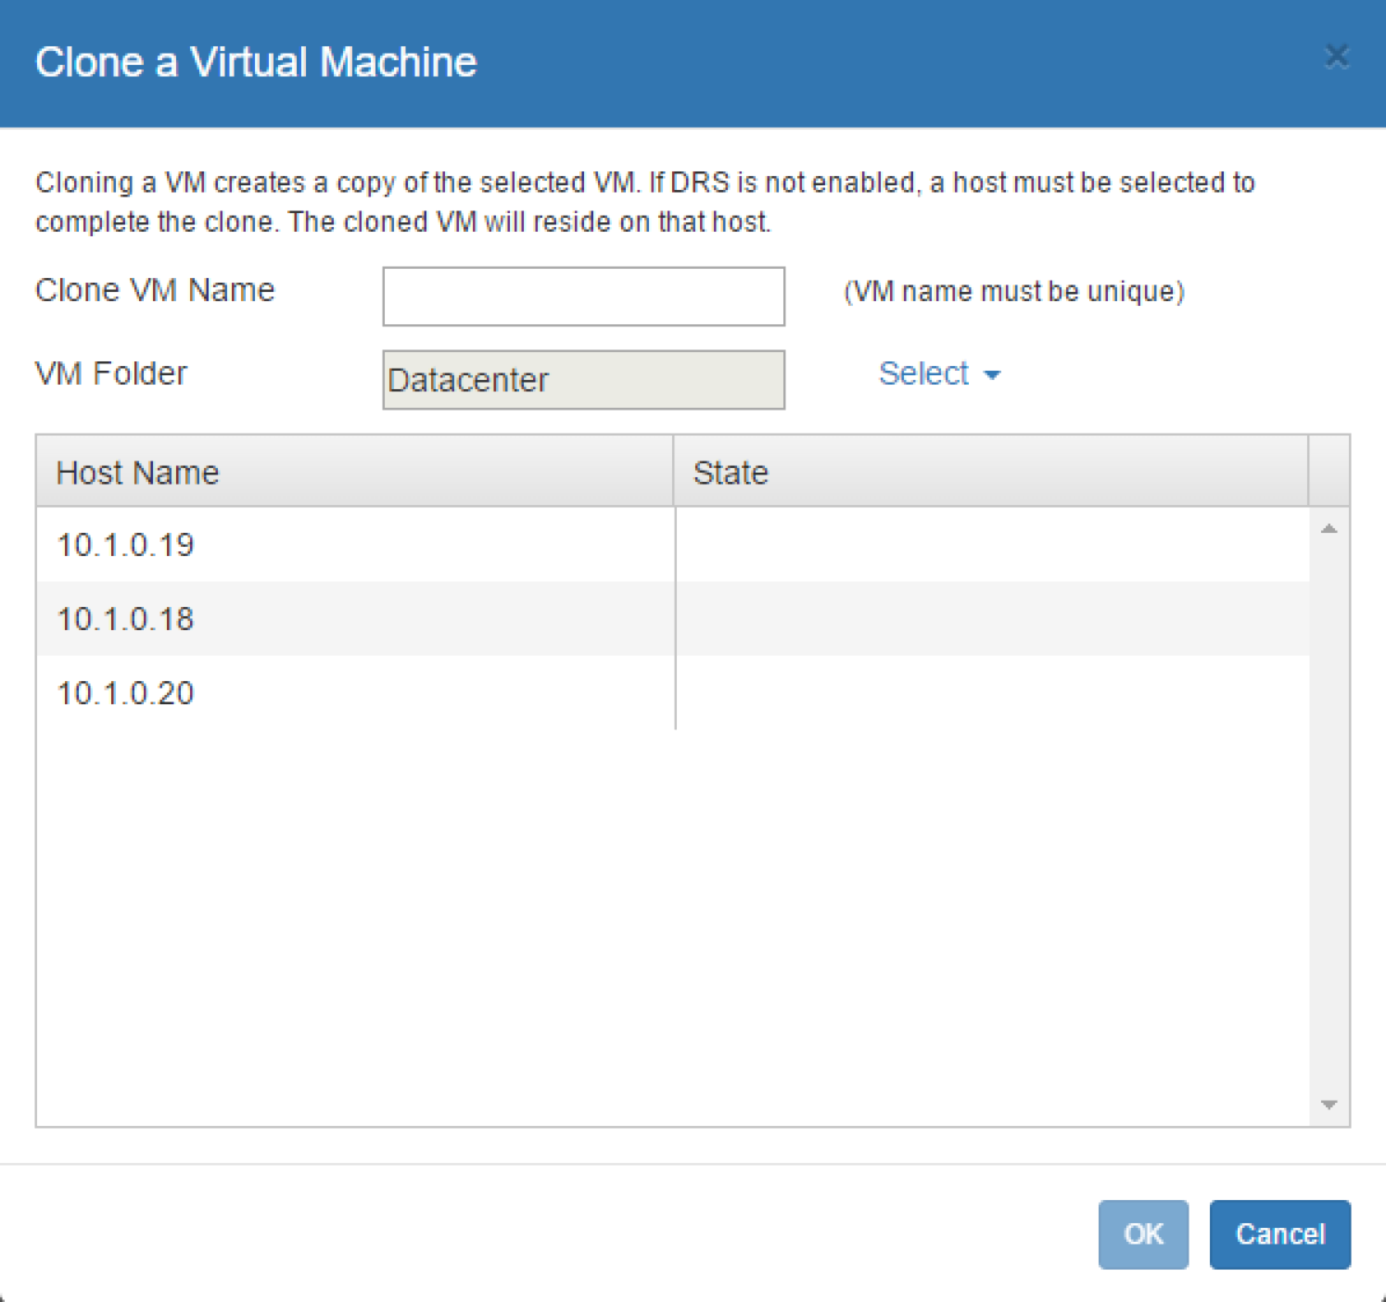
Clone
Same methodology as Maxta’s snapshot
Read/Write
Based on snapshot
Provide Clone Customization
Provide batch of clones

Slide 73
Space Reclaim (1)
In MxSP, objects can be removed and deleted.
Object removal
The object is removed from the MxInsight inventory. The object's data still exists on disk.
Object deletion
The object and its data are deleted from disk, thereby freeing disk space
Lazy delete

Slide 74
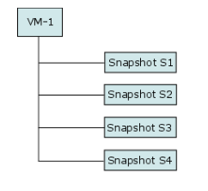
Space Reclaim (2)
Deleting from a VM/Snapshot Hierarchy
If you choose the default option to delete virtual machine VM-1 and its snapshots, VM-1 and snapshots S1-S4 are deleted and VM-1's capacity is reclaimed.
If you opt to delete only VM-1 and leave its snapshots, VM-1 is only removed from inventory. Since the remaining snapshots refer to VM-1, capacity is not reclaimed. In order to reclaim VM-1's space and remove the snapshots, all snapshots must be deleted.

Slide 75
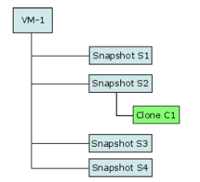
Space Reclaim (3)
Deleting from a VM/Snapshot Hierarchy
When deleting a parent object:
If you choose the default option to delete virtual machine VM-1 and its snapshots, VM-1 and snapshots S1-S4, are removed from MxInsight's inventory. However, capacity is not reclaimed since clone C1 refers to VM-1. Since Maxta snapshots do not take up any space on creation, no space is freed when deleting the snapshots. Capacity can be freed by deleting clone C1, thereby enabling MxSP to delete the parent object, VM-1.

Slide 76
Space Reclaim (4)
Deleting from a VM/Snapshot Hierarchy
When deleting a parent object:
If you opt to delete only VM-1 and leave its snapshots, VM-1 is only removed from the MxInsight inventory.
If you opt to delete VM-1 and its snapshots, the space is not reclaimed as clone C1 is still there.

Slide 77
Space Reclaim (5)
Deleting from a VM/Snapshot Hierarchy
When deleting a child object:
Any of the snapshots, S1-S4, can be deleted. However, since Maxta snapshots do not take up any space on creation, no space is freed when deleting the snapshots. The deleted snapshot is removed from MxInsight's inventory.
Capacity can be freed by deleting clone C1, thereby deleting any data that was associated with clone C1.
You can delete snapshot, VM-1 or C1 separately, there have no dependency.

Slide 78
Fault Management

Slide 79
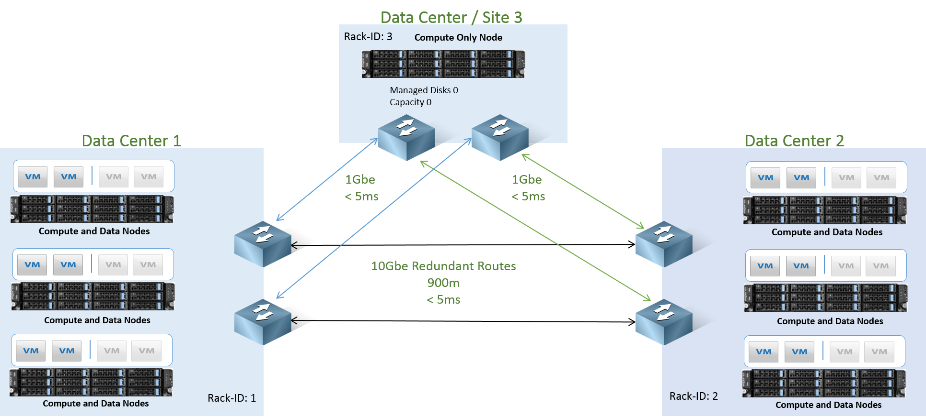
Eliminate Single Point of Failure
Protect Against Hardware Failures
Disk/node Failure
SSDs and HDDs
Rack Failure
Datacenter Failure
Protect Against Software Failures
VMware vSphere
Maxta Controller VM

Slide 80
HA Recommendations
Always ENABLE HA MODE on vCenter
Will automatically migrate guest VMs from failed node to another available node
Otherwise you will have guest VMs and applications go down
MFS is optimized to use NFS IP failover to make the fail over transparent to any application
Dual Redundant Links to Network Layer (Redundant Switches)
If multiple racks in Data Center, enable Rack Aware Node Assignments to ensure data is populated/distributed for maximum redundancy/ availability
Separate Network Links for Management if possible

Slide 81
Failure Types
Site/Rack failure
Enable Metro storage cluster
Node failure
Transient/Permanent
Replica resync initiated
HDD failure
Replica resync immediately
Service failure (tomcat/MFS/zookeeper/etc…)
Restart related service firstly
Flash Media failure
Mirroring enabled — Single failure has no impact
Replace the SSD
Mirroring disabled — Node permanent failure
replace the SSD and rebuild the full node

Slide 82
Fault Management (1)
Be designed to avoid having any single point of failure in the cluster
Replica Resync
A replica copy is lost, MxSP will mark that copy of data as stale
MxSP initiate a replica resync once it is marked as permanently lost
Support incremental rebuilds when there is a transient failure

Slide 83
Fault Management (2)
NFS IP failover
Each CVM has 3 private network interface
NFS: NFS IP
Peer: Fixed IP
Standby: Idel
A service on the management server goes down, or the node becomes unresponsive
nodes left with an idle standby interface will run an NFS IP leader election to take over the NFS IP of the failed node

Slide 84
NFS IP Failover
VM Guest
VM Guest
VM Guest
VMware vSphere (ESXi)
VMware vSphere (ESXi)
VMware vSphere (ESXi)
NFS IP Address 1
NFS IP Address 2
NFS IP Address 3
NFS IP Address 1
Maxta CVM
Maxta CVM
Maxta CVM
NFS Server
MFS
NFS Server
MFS
NFS Server
MFS
RDM
Physical Disk / SSD
RDM
Physical Disk / SSD
RDM
Physical Disk / SSD
No Downtime of Guest/Application VM
Simplified Non-Disruptive upgrade of Maxta CVM software (No vMotion of VMs necessary)

Slide 85
Fault Management (3)
Auto Migration
Guarantee that its unified namespace services are running on 3 nodes (2 copies)
Similar to NFS IP failure
Master failed, new master will be selected on the rest of nodes
Provide proactive balancing functionality

Slide 86
Scale-up and Scale-out
Maxta Global Namespace
Maxta Global Namespace
Maxta Global Namespace
Hypervisor
Hypervisor
Hypervisor
Hypervisor

Slide 87
Upgrade and Patching
Non Disruptively Upgrade Maxta Software
Minor and Major versions
Rolling Upgrade of Maxta Software on Each Server
ESX and Maxta can be Upgraded in a Rolling Manner

Slide 88
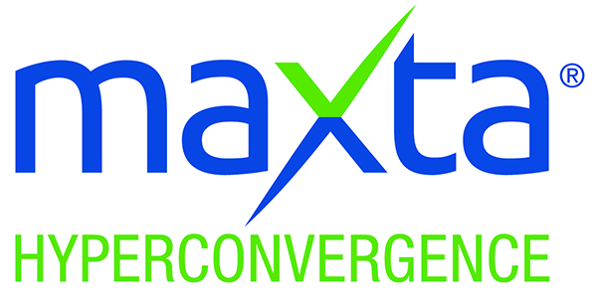




www.maxta.com
sales@maxta.com | 1-844-44MAXTA
www.linkedin.com/ company/maxta-inc-
www.youtube.com/c/MaxtaInc
www.facebook.com/ maxtacorp
@MaxtaInc

